Slide 1
Introduction to Software Metrics

Slide 2
Overview
  Software Quality Metrics
    Black Box Metrics
    White Box Metrics
    Development Estimates
    Maintenance Estimates

Slide 3
White Box Metrics
White Box Metrics
  Linguistic:
    LOC
    Halstead’s Software Science
  Structural:
    McCabe’s Cyclomatic Complexity
    Information Flow Metric
  Hybrid:
    Syntactic Interconnection

Slide 4
Types of White Box Metrics
  Linguistic Metrics
    measuring the properties of program/specification text without interpretation or ordering of the components.
  Structural Metrics
    based on structural relations between objects in program;
    usually based on properties of control/data flow graphs [e.g. number of nodes, links, nesting depth], fan-ins and fan-outs of procedures, etc.

Slide 5
  Hybrid Metrics
    based on combination (or on a function) of linguistic and structural properties of a program.

Slide 6
Smoke Test
It is common for a systems test group to have a small “Smoke Test Suite” which the system must pass before it is accepted by the independent test team for comprehensive system testing.
When a software development organization has a mature metrics program in place, the criteria for passing the smoke test often also requires documentation that the system has achieved certain metrics thresholds and passed certain automated static checks.

Slide 7
Linguistic Metrics
Lines of code/statements (LOC)
Perhaps the simplest:
  count the number of lines of code (LOC) and use as a measure of program complexity.
  Simple to use:
    if errors occur at 2% per line, a 5000 line program should have about 100 errors.
    If it required 30 tests to find an error, then could infer the expected number of tests needed per line of code.

Slide 8
LOC
Examples of use include:
  productivity KLOC/PM
  quality faults/KLOC
  cost $$/KLOC
  documentation doc_pages/KLOC

Slide 9
LOC
Various studies indicate:
  error rates ranging from 0.04% to 7% when measured against statement counts;
  LOC is as good for small programs
  LOC is optimistic for bigger programs.
  LOC appears to be rather linear for small programs (<100 lines),
  but increases non-linearity with program size.
  Correlates well with maintenance costs
  Usually better than simple guesses or nothing at all.

Slide 10
LOC
One study: a rough estimate of the average LOC to build one function point (FP):
Language | LOC/FP (average)
Assembly | 300
COBOL | 100
FORTRAN | 100
Pascal | 90
Ada | 70
00 Language | 30
4GL | 20
Code Generator | 15

Slide 11
Halstead's Software Science Metrics
Halstead [1977] based his "software science" on:
  common sense,
  information theory &
  psychology.
  His 'theory' is still a matter of much controversy.

Slide 12


Halstead's Software Science Metrics
Basic overview:
Based on two easily obtained program parameters:
  the number of distinct operators in program
  the number of distinct operands in program
Paired operators such as: "begin...end", "repeat...until" are usually treated as a single operator.
Other examples: =, do, if, goto, etc.

Slide 13
Contd…
number of unique (distinct) operators (n1)
number of unique (distinct) operands (n2)
total number of operators (N1)
total number of operands (N2).

Slide 14
Program length (N)
The program length (N) is the sum of the total number of operators and operands in the program:
N = N1 + N2

Slide 15
Vocabulary size (n)
The vocabulary size (n) is the sum of the number of unique operators and operands:
n = n1 + n2

Slide 16
Halstead's Volume
Halstead's volume (V) describes the size of the implementation of an algorithm.
The computation of V is based on the number of operations performed and operands handled in the algorithm.
Therefore V is less sensitive to code layout than the lines-of-code measures.

Slide 17
Program Length
Program volume (V) is the information contents of the program, measured in mathematical bits.
It is calculated as the program length times the 2-base logarithm of the vocabulary size (n):
Various other measures can also be obtained, for example:
V = N * log2(n)

Slide 18
Contd..
The volume of a function should be at least 20 and at most 1000.
The volume of a parameterless one-line function that is not empty; is about 20.
A volume greater than 1000 tells that the function probably does too many things.

Slide 19
Difficulty level (D)
The difficulty level or error proneness (D) of the program is proportional to the number of unique operators in the program.
D is also proportional to the ratio between the total number of operands and the number of unique operands (i.e. if the same operands are used many times in the program, it is more prone to errors).
D = ( n1 / 2 ) * ( N2 / n2 )

Slide 20
Program level (L)
The program level (L) is the inverse of the error proneness of the program.
I.e. a low level program is more prone to errors than a high level program.
L = 1 / D

Slide 21
Effort to implement (E)
The effort to implement (E) or understand a program is proportional to the volume and to the difficulty level of the program.
E = V * D

Slide 22
Time to implement (T)
The time to implement or understand a program (T) is proportional to the effort.
Empirical experiments can be used for calibrating this quantity.
Halstead has found that dividing the effort by 18 gives an approximation for the time in seconds.
T = E / 18

Slide 23
Number of delivered bugs (B)
The number of delivered bugs (B) correlates with the overall complexity of the software.
Halstead gives the following formula for B:
B = ( E ** (2/3) ) / 3000

Slide 24
Bugs (B)
Halstead's delivered bugs (B) is an estimate for the number of errors in the implementation.
Delivered bugs in a file should be less than 2.
Experiences have shown that, when programming with C or C++, a source file almost always contains more errors than B suggests.
The number of defects tends to grow more rapidly than B.

Slide 25
voidsort( int*a, intn ) {
inti, j, t;
if( n <2 ) return;
for( i=0 ; i <n-1; i++) {
for( j=i+1 ; j <n ; j++) {
if( a[i] > a[j]) {
t=a[i];
a[i] =a[j];
a[j]=t;
}
}
}
}

Slide 26
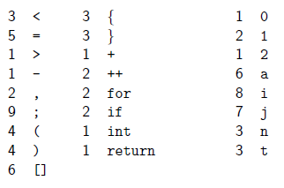
Ignore the function definition & Count operators and operands

Slide 27
Contd…
Total Unique
Operators N1 = 50 n1 = 17
Operands N2 = 30 n2 = 7
V = 80 log2(24) ≈392

Slide 28
Contd…
Difficulty: D = ( n1 / 2 ) * ( N2 / n2 )
Example: 17/2 * 30/7 ≈36

Slide 29
Halstead’s Software Science - Eexample
int f=1, n=7;
for (int i=1; i<=n; i+=1)
f*=i;
An “operator” is a fixed symbol or reserved word in a language, and “operand” is everything else: variable names, function names, numeric constants, etc. Comments don’t count.

Slide 30
Contd…
define n1 to be the number of unique operators, in the example there are 10:
int = , ; for ( <= += ) *=
define n2 to be the number of unique operands, in the example there are 5:
f 1 n 7 i

Slide 31
Contd…
define N1 to be the number of operators, in the example there are 16:
int = , = ; for ( int = ; <= ;
+= ) *= ;
define N2 to be the number of operands, in the example there are 12:
f 1 n 7 i 1 i n i 1 f i

Slide 32
Contd…
define N, the length of the program to be: N1+N2 ➔28
define V, the volume of the program, to be:
N × log₂(n1 + n2) ➔ 109.4
define D, the difficulty of the program, to be:
(n1 × N2) ÷ (n2 × 2) ➔ 12

Slide 33
Contd…
define E, the effort required to write the program, to be:
D × V ➔ 1312.8
calculate B, the number of bugs you should expect in the program as:
E^{0.667}÷3000 ➔ 0.04
calculate T, the time it took to write the program as:
E÷18 seconds ➔ 73 seconds

Slide 34
Use of Halstead’s Metrics
Known weaknesses:
  Call depth not taken into account
    a program with a sequence 10 successive calls more complex than one with 10 nested calls
  An if-then-else sequence given same weight as a loop structure.
  Added complexity issues of nesting if-then-else or loops not taken into account, etc.

Slide 35
Structural Metrics
  McCabe’s Cyclomatic Complexity
    Control Flow Graphs

Slide 36
McCabe Metrics
Cyclomatic Complexity Metric (v(G))
  Cyclomatic Complexity (v(G)) is a measure of the complexity of a module's decision structure.
  It is the number of linearly independent paths and therefore, the minimum number of paths that should be tested.

Slide 37
McCabe’s Cyclomatic Complexity
Determines the logical complexity of a graph
  typically the graph is a flow graph of a function or procedure
  can also be a graphical representation of an FSM.
Define:
  Independent path: any path that introduces at least one new set of statements or a new condition &
  At least one edge that has not been traversed before.
  Basis Set: a set of independent paths (covers all conditions and statements).

Slide 38
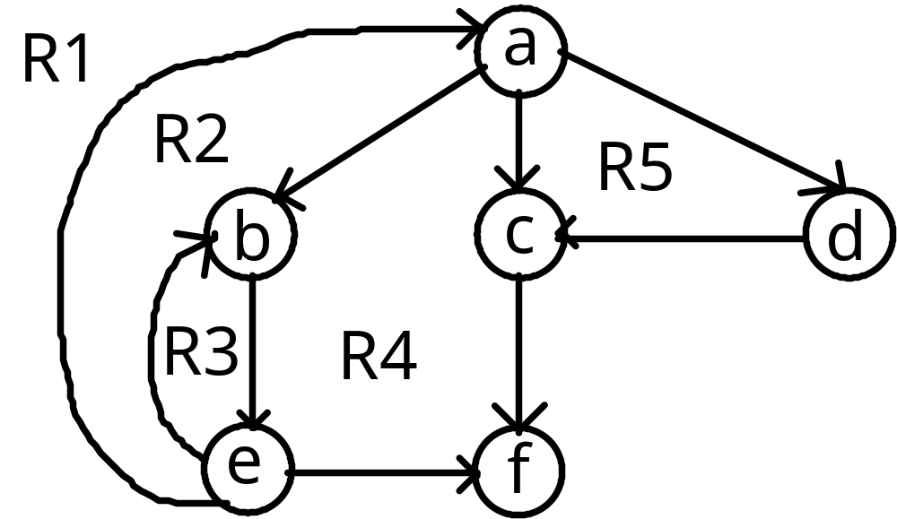
McCabe’s Cyclomatic Complexity
Example: set of independent paths which comprise a basis set for the following flow graph:
Path1: a, c, f
Path2: a, d, c, f
Path3: a, b, e, f
Path4: a, b, e, b, e, f
Path5: a, b, e, a, c, f

Slide 39
McCabe’s Cyclomatic Complexity
Alternate methods to calculate V(G):
  V(G) = #of_predicate_nodes + 1
  V(G) = #of_edges - #of_nodes + 2
Note: in previous graph node ‘a’ has an out degree of 3, thus it counts as 2 predicate nodes.

Slide 40
How Many Paths Through the Program?
IF credit rating > = 4
THEN
approve
ELSE
IF (income >= 100,000) AND
(number of children < 3)
THEN
approve
ELSE
disapprove

Slide 41
How Many Paths Through the Program?
credit rating >= 4?
N
Y
3
Approve
1
4
income >=100,000?
2
Y
N
Y
children < 3?
N
Disapprove

Slide 42
Loop Example
credit rating >= 4?
Y
N
1
Approve
income >=100,000?
5
Y
Y
2
N
3
4
N
children < 3?
Disapprove
More?
Now how many paths?

Slide 43
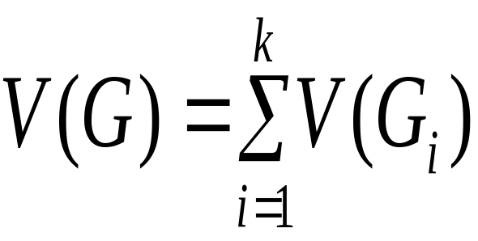
McCabe’s Cyclomatic Complexity
A predicate node is a node in the graph with 2 or more out going arcs.
In the general case, for a collection of C control graphs with k connected components, the complexity is equal to the summation of their complexities. That is

Slide 44
Contd…
voidsort( int*a, intn ) {
inti, j, t;
if( n < 2 ) return;
for( i=0 ; i < n-1; i++ ) {
for( j=i+1 ; j < n ; j++ ) {
if( a[i] > a[j] ) {
t= a[i];
a[i] = a[j];
a[j] = t;
}
}
}
}

Slide 45
Count Ifs and LOOPs
IF: 2, LOOP: 2
v(G) = 5

Slide 46
Example 3
IF A = 354
THEN IF B > C
THEN A = B
ELSEA= C
ENDIF
ENDIF
Print A

Slide 47
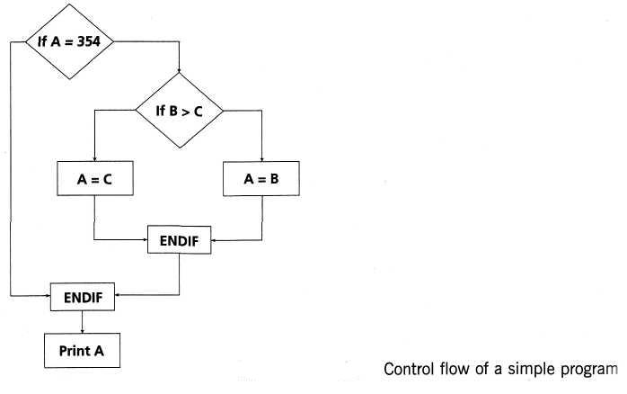

Slide 48
Example 3
The control flow shows seven nodes (shapes) and eight edges (lines), thus using the formal formula the cyclomatic complexity is 8-7 + 2 = 3. In this case there is no graph called or subroutine.
Alternatively one may calculate the cyclomatic complexity using the decision points rule. Since there are two decision points, the cyclomatic complexity is 2 + 1 = 3.

Slide 49
McCabe’s Limit
The precise number to use as a limit, however, remains somewhat controversial.
The original limit of 10 as proposed by McCabe has significant supporting evidence, but limits as high as 15 have been used successfully as well.

Slide 50
McCabe’s Limit
Limits over 10 should be reserved for projects that have several operational advantages over typical projects, for example experienced staff, formal design, a modern programming language, structured programming, code walkthroughs, and a comprehensive test plan.
In other words, an organization can pick a complexity limit greater than 10, but only if it is sure it knows what it is doing and is willing to devote the additional testing effort required by more complex modules.

Slide 51
Maintainability Index (MI)
MI1 = 171 – 5.2 ln(V) – 0.2V(g) – 16.2 ln(LOC)

Slide 52
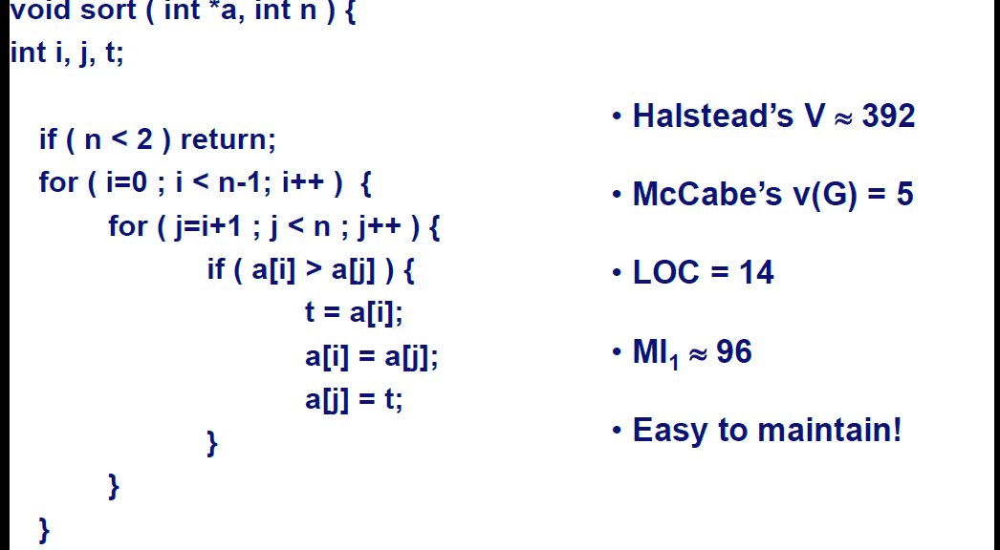
Contd…

Slide 53
Case Study
An interesting case study was performed by Basili et al.
The following table illustrates the average distribution of effort across maintenance types:
Maintenance Activity | Effort
Enhancement | 61%
Correction | 14%
Adaptation | 5%
Other | 20%

Slide 54
Case Study
The enhancement activities typically involved more SLOC (Source Lines of Code) than error corrections.
  verifies the intuitive notion that error corrections usually result in minor local changes.

Slide 55
Contd…
What about the distribution of effort within each maintenance activity?
  The following efforts can be examined:
    analysis ( examine different implementations and their associated costs),
    isolation (time spent to understand the failure or requested enhancement),
    design (time spent in redesigning the system),
    code/unit test and,
    inspection, certification and consulting.

